Slide 1
ENME601 Thermodynamics
Tutorial Session
Presenter : Dr. Jay Wang

Slide 2
Tutorial Questions (Week 6) Q1-Q5 Guidelines

Slide 3
Tutorial Question Q1
Q1) A steam power plant with a power output of 150 MW consumes coal at a rate of 60 tons/h. If the heating value of the coal is 30,000 kJ/kg, determine the overall efficiency of this plant.
$$η=\frac{Q_{actual}}{Q_{theoretical}}=\frac{MW}{MW}$$

Slide 4
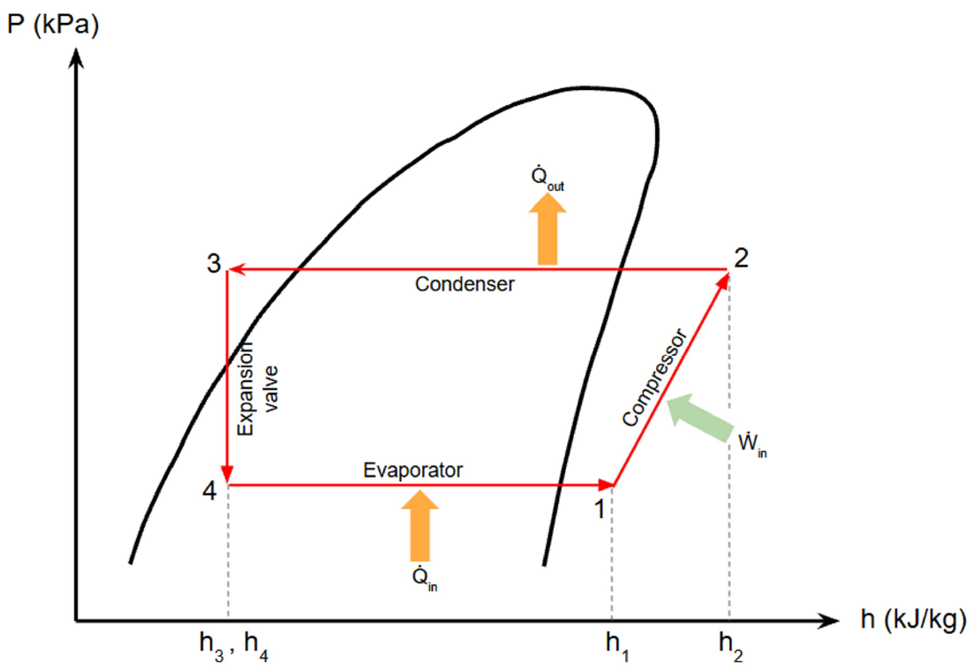
Tutorial Question Q2
Q2) A heat pump that is used to heat a house has a COP of 2.5. That is, the heat pump delivers 2.5 kWh of energy to the house for each 1 kWh of electricity it consumes. Is this a violation of the ﬁrst law of thermodynamics? Explain.

Slide 5
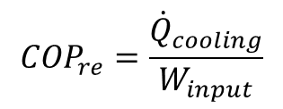

Tutorial Question Q3
Q3) A household refrigerator that has a power input of 450 W and a COP of 1.5 is to cool 5 large watermelons, 10 kg each, to 8°C. If the watermelons are initially at 28°C, determine how long it will take for the refrigerator to cool them. The watermelons can be treated as water whose speciﬁc heat is 4.2 kJ/kg·°C.
$${COP}_{re}=\frac{{\dot{Q}}_{cooling}}{W_{input}}$$
$$ΔQ_{load}=mC_{p}ΔT$$
$$Δt=\frac{ΔQ_{load}}{{\dot{Q}}_{cooling}}$$

Slide 6
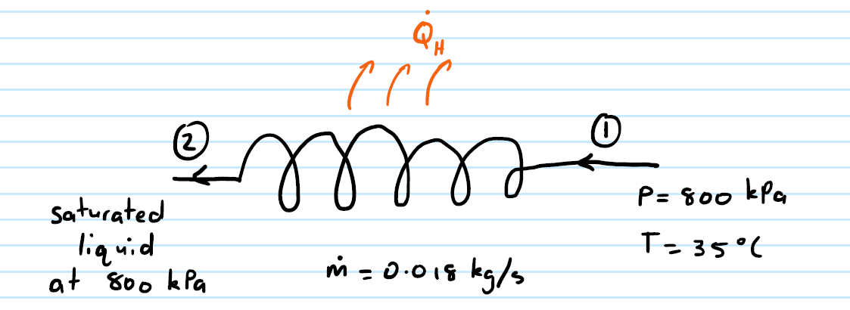


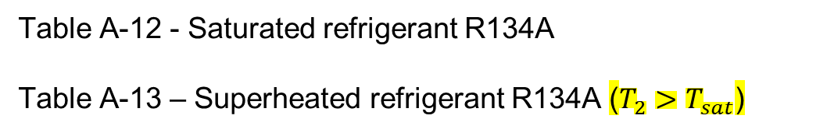
Tutorial Question Q4
Q4) Refrigerant-134a enters the condenser of a residential heat pump at 800 kPa and 35°C at a rate of 0.018 kg/s and leaves at 800 kPa as a saturated liquid. If the compressor consumes 1.2 kW of power, determine (a) the COP of the heat pump and (b) the rate of heat absorption from the outside air.
$$COP=\frac{{\dot{Q}}_{heat}}{{\dot{W}}_{input}}=\frac{\dot{m}(h_{2}−h_{1})}{{\dot{W}}_{input}}$$
Table A-12 - Saturated refrigerant R134A
Table A-13 – Superheated refrigerant R134A ($T_{2}>T_{sat}$)
${\dot{Q}}_{cool}={\dot{Q}}_{heat}−$ ${\dot{W}}_{input}$

Slide 7


Tutorial Question Q5
Q5) A Carnot heat engine operates between a source at 1000 K and a sink at 300 K. If the heat engine is supplied with heat at a rate of 800 kJ/min, determine (a) the thermal efficiency and (b) the power output of this heat engine.
$$η_{rev}=1−\frac{T_{L}}{T_{H}}$$
$${\dot{W}}_{out}={\dot{Q}}_{H}×η_{rev}$$

